Slide 1
Stats 101C Project
LAFD Data
Team Name: Albino Snow Leopards
Carson Zhao (email: carsonzhao333@gmail.com)
Leon Luc (email: lluc507@g.ucla.edu)
Andreas Hierl (email: hierl.andy@gmail.com)

Slide 2
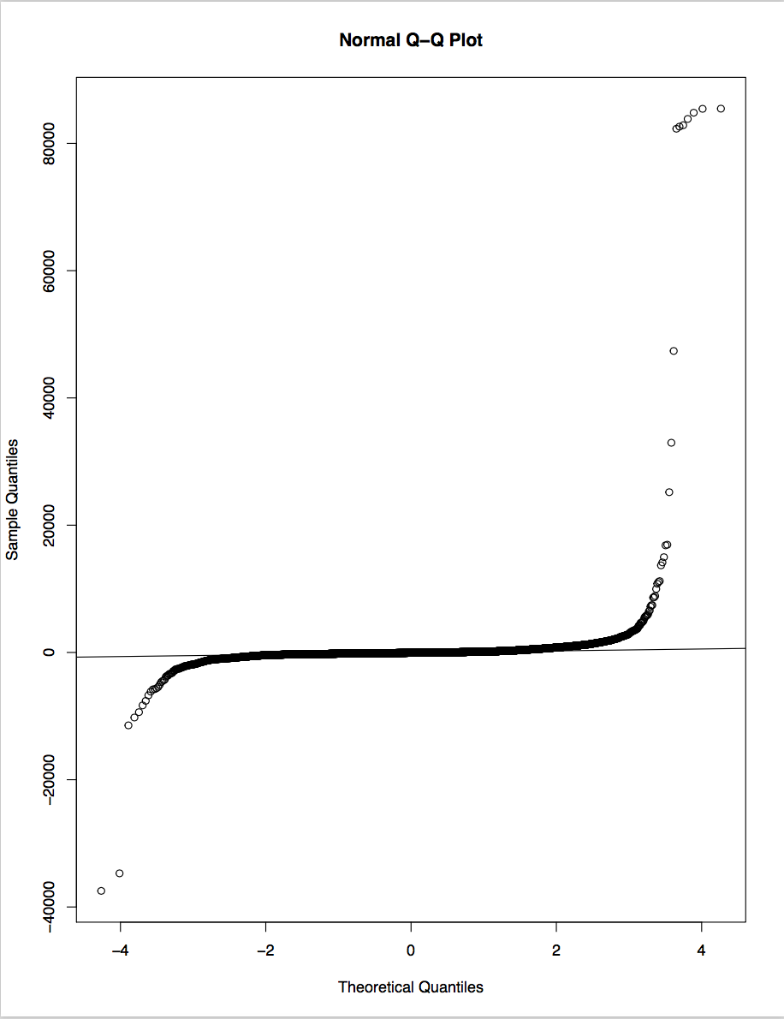


Exploratory Analysis
The response variable elapsed time has many outliers
Does not follow normal distribution according to Normal Q-Q Plot
Summary statistics of elapsed time
98th through 100th percentile of elapsed time

Slide 3
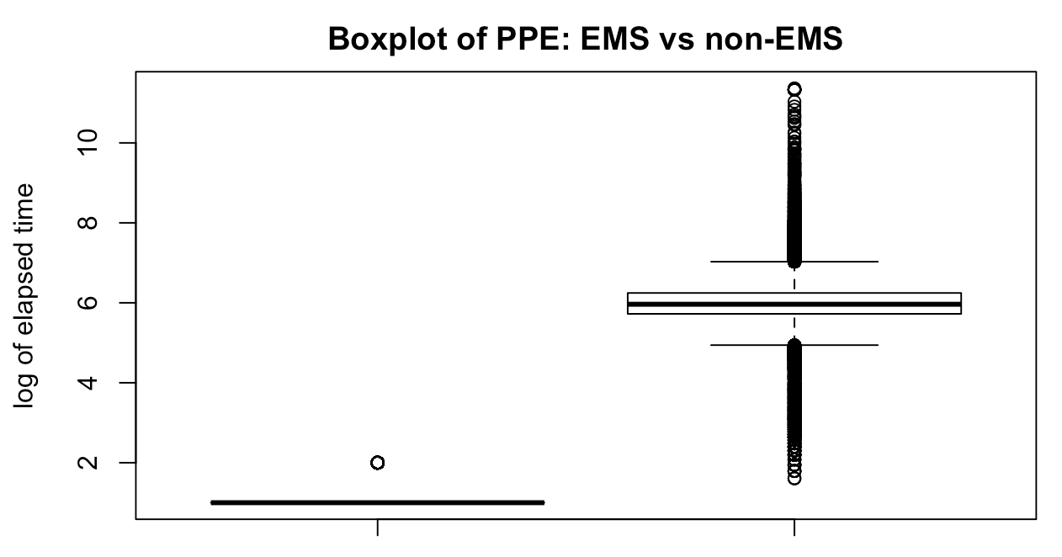
Exploratory Analysis (2)
PPE variable: difference in mean of elapsed time between group EMS and group non-EMS significantly different according to t-test
P-value of < 0.001
Variance Inflation Factors
No VIFs greater than 10
Correlations between numeric values less than 0.3 (weak association)
No multicollinearity problem

Slide 4
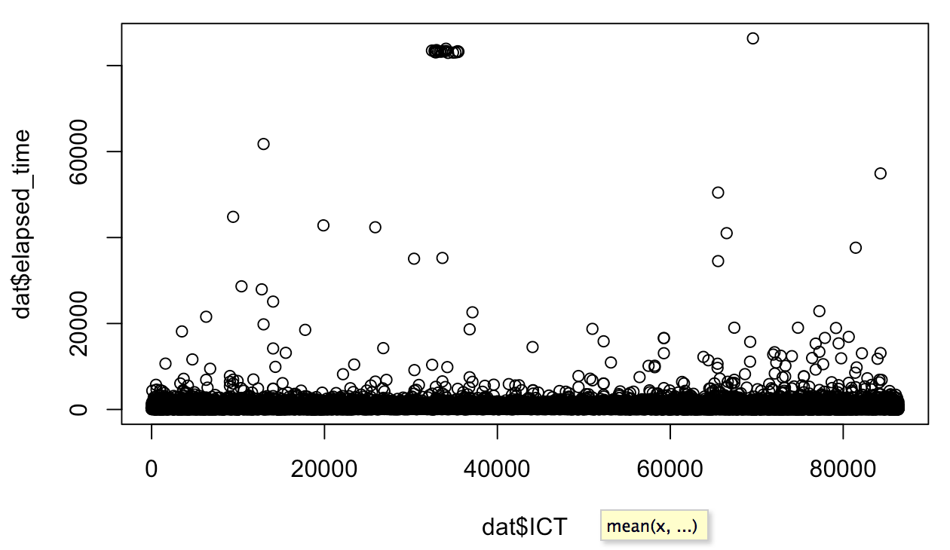
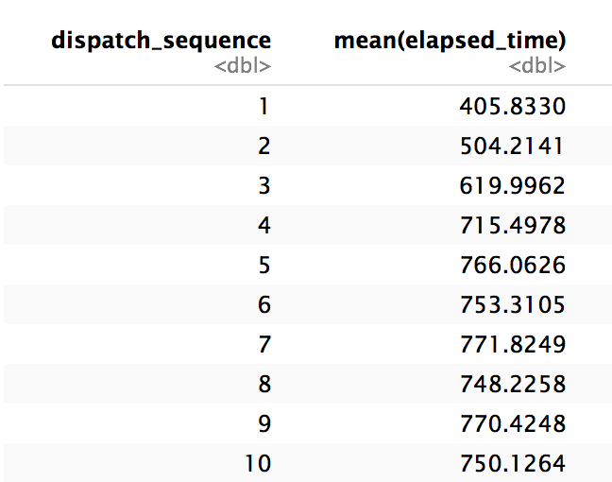
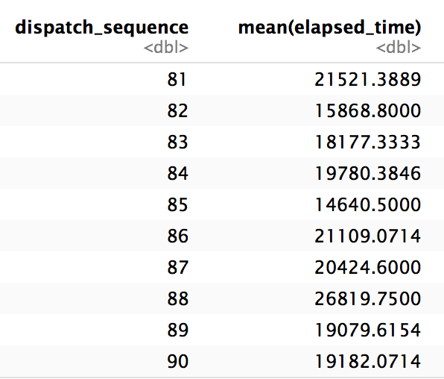
Exploratory Analysis (3)
Scatterplot of ICT vs elapsed time
Notice the outliers
Dispatch Sequence vs elapsed time
As dispatch sequence increases, the mean of elapsed time generally increases as well

Slide 5
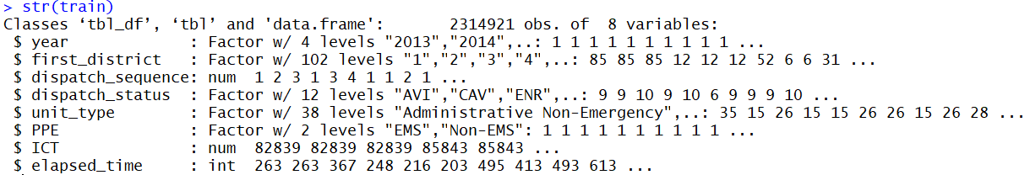
How we did it: Variables
Renamed them for convenience and simplicity
i.e. First in District -> first_district
Dropped row.id, incident.id, and Emergency Dispatch Code
Did not provide crucial information for prediction
Factors: year, first_district, dispatch_status, unit type, PPE
Numeric: elapsed_time, dispatch_sequence, ICT

Slide 6
How we did it: Cleaning the Data
Omitted observations in train with missing values
2774370 observations -> 2314924 observations
Removed observations in train with Dispatch Sequence > 156
Test data did not have any Dispatch Sequence > 156
Replaced NA’s in test using a predictive model
Missing Dispatch Sequences replaced using linear regression based on all variables excluding the response elapsed time
Drop unused factor levels in train variable unit_type
“Fire Chief” and “Planning Trailer” were not in the test data set
For XGBoost, we had to “binarize” the data
Make a binary (0 or 1) column for each factor level

Slide 7
Other Models Attempted
Polynomial Regression
Second best Kaggle score
5th degree polynomial for numeric variables
PLS and PCA
Too many categorical (factor) levels to run
Random Forest
Overfit, Kaggle MSE much higher than training MSE
Splines, GAMs
Best Subset
Lasso and Ridge
Boosting

Slide 8
Our Approach
Algorithm: XGBoost
Function Parameters:
Eta = 0.050
Maax_depth = 3
Gamma = 0
Colsample_bytree = 0.8
Min_child_weight = 5
Subsample = 1
Nrounds = 100
Used 5-fold Cross-Validation to find “best” tuning parameters in terms of MSE
Tried with a bunch of different combinations of the many tuning parameters
Adjusted for overfit/underfit after each running of the model
Note: about 30% of training data was used

Slide 9
What is XGBoost?
A boosted tree algorithm
“Tree” - the model creates, in our case, regression trees
By themselves, they are usually weaker models
“Boosted” - new trees are created based off of subsequently created trees
This builds a strong model off of the many weaker models already created.
It’s quick to run (relatively)

Slide 10

Model Results
Kaggle MSE: 1429982.55420
Test MSE (from rest of training dataset): 1292198
Summaries of our predicted elapsed_time values, and of the training elapsed_time values, respectively

Slide 11
Things we could have done better
Outliers: how to better predict them?
High MSE due to inability to predict outliers in testing data
Making Dispatch Sequence in train exactly match Dispatch Sequence in test
Better tuning parameters for XGBoost, and Random Forests
Use more of the training data (unable to run at certain amount)
Account for interaction effects between variables
Add/Create more variables and features to the data set

